Slide 1
Deformable Detr

Slide 2
Paper Details
Paper Title: DEFORMABLE DETR: DEFORMABLE TRANSFORMERS FOR END-TO-END OBJECT DETECTION
Publication Date: 18 Mar 2021
Publisher: Xizhou Zhu, Weijie Su
Affiliation: SenseTime Research, University of Science and Technology of China, The Chinese University of Hong Kong
Conderence: ICLR

Slide 3
Motivation
Drawback DETR
slow convergence
high complexity
low performance in detecting small objects
Effiecient Attention Mechanism
use pre-defined sparse attention
learn data-dependent sparse attention
explore the low-rank property in self-attention
Multi-scale Feature Representation for Object Detection

Slide 4
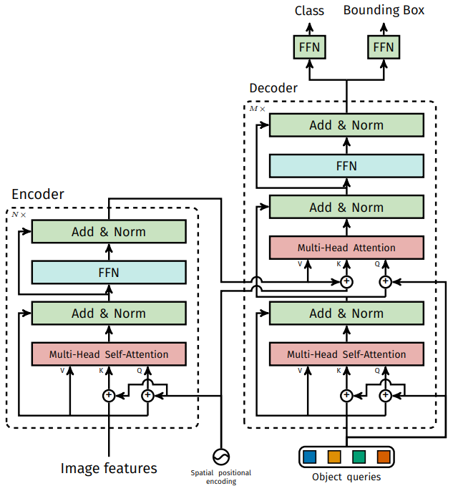
Motivation
Drawback DETR
slow convergence
Notes:
This is mainly because the attention modules processing image features are difficult to train. For example, at initialization, the cross-attention modules are almost of average attention on the whole feature maps. While, at the end of the training, the attention maps are learned to be very sparse, focusing only on the object extremities.

Slide 5

Motivation
Drawback DETR
slow convergence
high complexity
Complexity of Multihead attention
Notes:
High complexity refers to computatianal and memory complexity. Here we talk about the computational one. And the proeminent part is the third term

Slide 6

Motivation
Drawback DETR
slow convergence
high complexity
Complexity of Multihead attention
Complexity of self-attention in encoder
Notes:
High complexity refers to computatianal and memory complexity.

Slide 7


Motivation
Drawback DETR
slow convergence
high complexity
Complexity of Multihead attention
Complexity of self-attention in encoder
Complexity of cross-attention in decoder
Complexity of self-attention in decoder
Notes:
High complexity refers to computatianal and memory complexity.

Slide 8
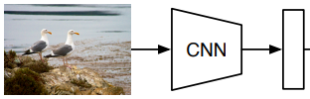


Motivation
Drawback DETR
slow convergence
high complexity
low performance in detecting small objects
Notes:
The input of the detr is a feature map from a resnet backbone.

Slide 9
Motivation
Drawback DETR
slow convergence
high complexity
low performance in detecting small objects
Effiecient Attention Mechanism
pre-defined sparse attention
Notes:
The first category is to … . The most straightforward paradigm is restricting the attention pattern to be fixed local windows. Most works follow this paradigm. Although restricting the attention pattern to a local neighborhood can decrease the complexity, it loses global information. To compensate this, some works attend key elements at fixed intervals to significantly increase the receptive field on keys. And some works allow a small number of special tokens having access to all key elements.

Slide 10
Motivation
Drawback DETR
slow convergence
high complexity
low performance in detecting small objects
Effiecient Attention Mechanism
pre-defined sparse attention
learn data-dependent sparse attention
Notes:
The second category is to … . A work proposes a locality sensitive hashing (LSH) based attention, which hashes both the query and key elements to different bins. A similar idea is proposed by another work, where k-means finds out the most related keys. and Some other work learns block permutation for block-wise sparse attention.

Slide 11
Motivation
Drawback DETR
slow convergence
high complexity
low performance in detecting small objects
Effiecient Attention Mechanism
pre-defined sparse attention
learn data-dependent sparse attention
explore the low-rank property in self-attention
Notes:
The third category is to … . A work reduces the number of key elements through a linear projection on the size dimension instead of the channel dimension. Some works rewrite the calculation of selfattention through kernelization approximation.

Slide 12
Motivation
Drawback DETR
slow convergence
high complexity
low performance in detecting small objects
Effiecient Attention Mechanism
pre-defined sparse attention
learn data-dependent sparse attention
explore the low-rank property in self-attention
Notes:
Some works tried the first category in the image domain. But such approaches are much slower in implementation than traditional convolution, because the intrinsic limitation in memory access patterns. Their proposed deformable attention module is inspired by deformable convolution, and belongs to the second category. It only focuses on a small fixed set of sampling points predicted from the feature of query elements. This one they find out that it is just slightly slower than the traditional convolution.

Slide 13
Motivation
Drawback DETR
slow convergence
high complexity
low performance in detecting small objects
Effiecient Attention Mechanism
use pre-defined sparse attention
learn data-dependent sparse attention
explore the low-rank property in self-attention
Multi-scale Feature Representation for Object Detection
Notes:
One of the main difficulties in object detection is to effectively represent objects at vastly different scales. Modern object detectors usually exploit multi-scale features to accommodate this.

Slide 14

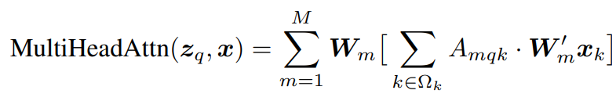
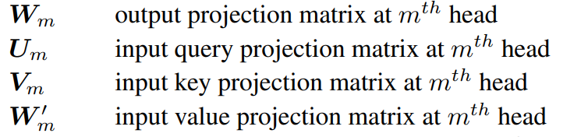

Deformable Transformer
Deformable attetion module
Notes:
The attention feature is calculated

Slide 15

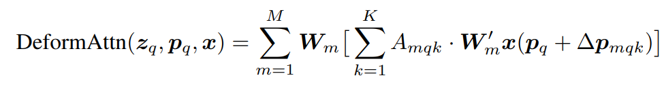
Deformable Transformer
Deformable attetion module
Notes:
Pq is a 2-d reference point, delta pmqk denotes the sampling offset. And the big K is the total sampled key number

Slide 16
Deformable Transformer
Deformable attetion module
Softmax from Zq (1MK channels)
Linear projection from Zq (2MK channels)
Notes:
Both ∆pmqk and Amqk are obtained via linear projection over the query feature zq. In implementation, the query feature zq is fed to a linear projection operator of 3MK channels, where the first 2MK channels encode the sampling offsets ∆pmqk, and the remaining MK channels are fed to a softmax operator to obtain the attention weights Amqk.

Slide 17
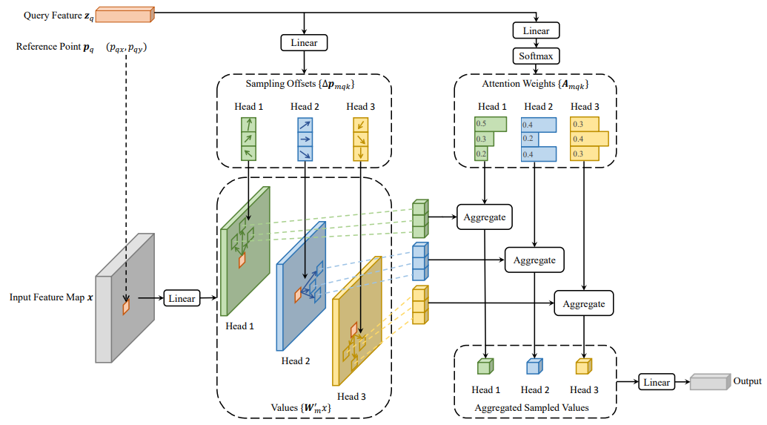
Deformable Transformer
Deformable attetion module
Notes:
Both ∆pmqk and Amqk are obtained via linear projection over the query feature zq. In implementation, the query feature zq is fed to a linear projection operator of 3MK channels, where the first 2MK channels encode the sampling offsets ∆pmqk, and the remaining MK channels are fed to a softmax operator to obtain the attention weights Amqk.
Here we have an Illustration of the proposed deformable attention module.

Slide 18

Deformable Transformer
Deformable attetion module
Calculate offsets and attention weights
Calculate the equation
Calculate whole
Notes:
In our experiments, M = 8, K ≤ 4 and C = 256 by default, thus 5K + 3MK < C and the complexity is of O(2NqC 2 + min(HW C2 , NqKC2 ))

Slide 19




Deformable Transformer
Deformable attetion module
encoder
cross-attention
Notes:
In our experiments, M = 8, K ≤ 4 and C = 256 by default, thus 5K + 3MK < C and the complexity is of O(2NqC 2 + min(HW C2 , NqKC2 ))

Slide 20
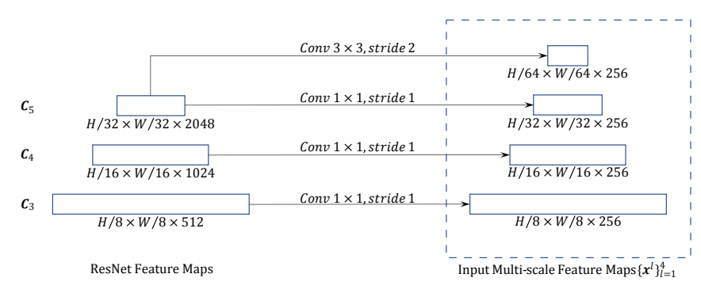
Deformable Transformer
Deformable attetion module
Multi-scale Deformable Attention Module
Notes:
This is how they an illustration for Constructing mult-scale feature maps for Deformable DETR

Slide 21
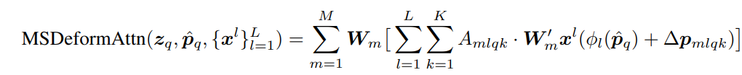
Deformable Transformer
Deformable attetion module
Multi-scale Deformable Attention Module
Notes:
This is how they an illustration for Constructing mult-scale feature maps for Deformable DETR

Slide 22

Deformable Transformer
Deformable attetion module
Multi-scale Deformable Attention Module
Notes:
Let {x l} L l=1 be the input multi-scale feature maps, Function φl(pˆq) in Equation 3 re-scales the normalized coordinates pˆq to the input feature map of the l-th level. The multi-scale deformable attention is very similar to the previous single-scale version, except that it samples LK points from multi-scale feature maps instead of K points from single-scale feature maps.

Slide 23
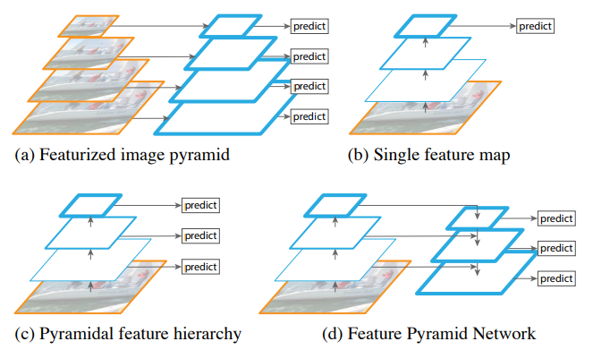
Deformable Transformer
Deformable attetion module
Multi-scale Deformable Attention Module
Notes:
Note that the top-down structure in FPN (Lin et al., 2017a) is not used, because our proposed multi-scale deformable attention in itself can exchange information among multi-scale feature maps. . To identify which feature level each query pixel lies in, we add a scale-level embedding, denoted as el , to the feature representation, in addition to the positional embedding. Different from the positional embedding with fixed encodings, the scale-level embedding {el} L l=1 are randomly initialized and jointly trained with the network.

Slide 24
Deformable Transformer
Deformable attetion module
Multi-scale Deformable Attention Module
Deformable Transformer Decoder
Cross-Attention and Self-attention
Notes:
The query elements for both types of attention modules are of object queries. In the cross attention modules, object queries extract features from the feature maps, where the key elements are of the output feature maps from the encoder. In the self-attention modules, object queries interact with each other, where the key elements are of the object queries. Since our proposed deformable attention module is designed for processing convolutional feature maps as key elements, we only replace each cross-attention module to be the multi-scale deformable attention module, while leaving the self-attention modules unchanged.

Slide 25

Deformable Transformer
Deformable attetion module
Multi-scale Deformable Attention Module
Deformable Transformer Decoder
Bounding box -> relative offsets w.r.t the reference point
Predicted from its object query embedding via a learnable linear projection followed by a sigmoid function
2-d normalized coordinate
Notes:
For each object query, the 2-d normalized coordinate of the reference point pˆq is predicted from its object query embedding via a learnable linear projection followed by a sigmoid function.

Slide 26

Deformable Transformer
Deformable attetion module
Multi-scale Deformable Attention Module
Deformable Transformer Decoder
Bounding box -> relative offsets w.r.t the reference point
Notes:
Bqx, Bqy, Bqw, Bqh are predicted by the detection head. Sigmoid and inverse sigmoid if to ensure our bq has normalized coordinates.

Slide 27
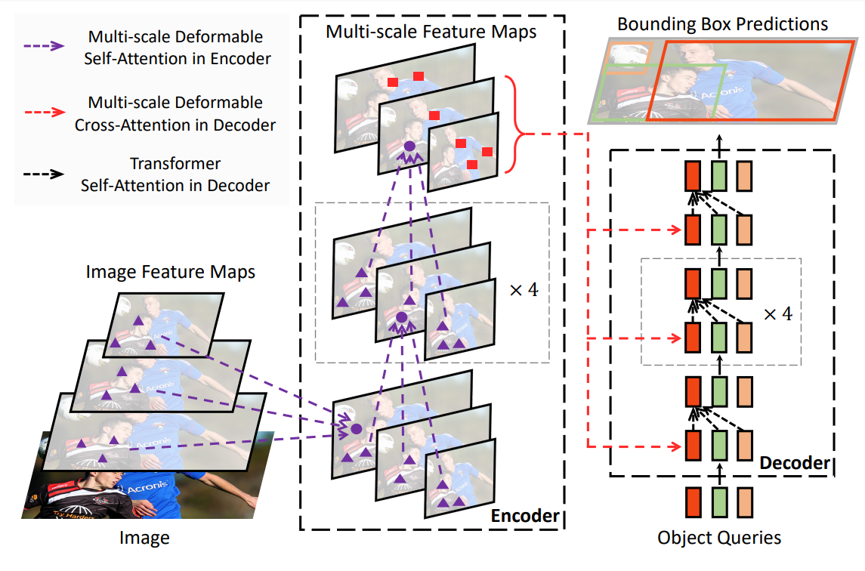
Deformable Transformer
Deformable attetion module
Multi-scale Deformable Attention Module
Deformable Transformer Decoder
Notes:
Bqx, Bqy, Bqw, Bqh are predicted by the detection head. Sigmoid and inverse sigmoid if to ensure our bq has normalized coordinates.

Slide 28


Addtional Improvements
Iterative Bounding Box Refinement.
Notes:
We establish a simple and effective iterative bounding box refinement mechanism to improve detection performance. Each decoder layer refines the bounding boxes based on the predictions from the previous layer. To stabilize training, the gradients only back propagate through ∆b d q{x,y,w,h} , and are blocked at σ −1 ( ˆb d−1 q{x,y,w,h} ).

Slide 29
Addtional Improvements
Iterative Bounding Box Refinement.
Two-Stage Deformable DETR (Region proposal/Encoder/Top scoring)
Notes:
In the original DETR, object queries in the decoder are irrelevant to the current image. Inspired by two-stage object detectors, we explore a variant of Deformable DETR for generating region proposals as the first stage. The generated region proposals will be fed into the decoder as object queries for further refinement, forming a two-stage Deformable DETR. In the first stage, to achieve high-recall proposals, each pixel in the multi-scale feature maps would serve as an object query. However, directly setting object queries as pixels will bring unacceptable computational and memory cost for the self-attention modules in the decoder, whose complexity grows quadratically with the number of queries. To avoid this problem, we remove the decoder and form an encoder-only Deformable DETR for region proposal generation.

Slide 30
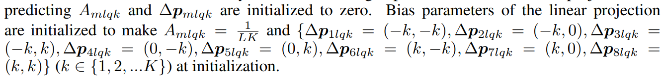
Addtional Improvements
Iterative Bounding Box Refinement.
Two-Stage Deformable DETR (Region proposal/Encoder/Top scoring)
Notes:
In the original DETR, object queries in the decoder are irrelevant to the current image. Inspired by two-stage object detectors, we explore a variant of Deformable DETR for generating region proposals as the first stage. The generated region proposals will be fed into the decoder as object queries for further refinement, forming a two-stage Deformable DETR. In the first stage, to achieve high-recall proposals, each pixel in the multi-scale feature maps would serve as an object query. However, directly setting object queries as pixels will bring unacceptable computational and memory cost for the self-attention modules in the decoder, whose complexity grows quadratically with the number of queries. To avoid this problem, we remove the decoder and form an encoder-only Deformable DETR for region proposal generation.

Slide 31
Experiments
Parameters of the deformable Transformer encoder are shared among different feature levels
Focal loss
Notes:
One thing about the experiments is that …

Slide 32
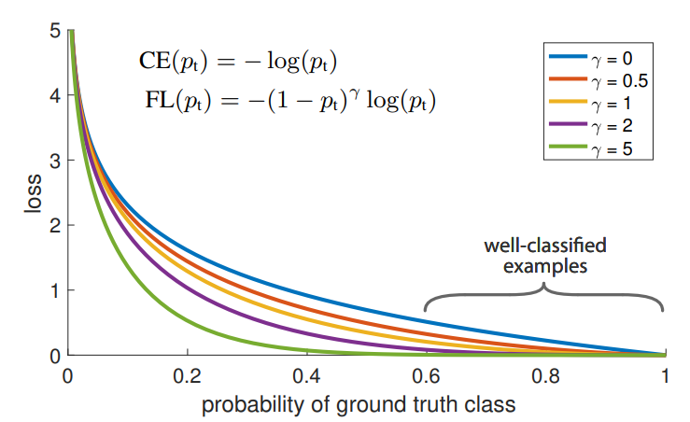
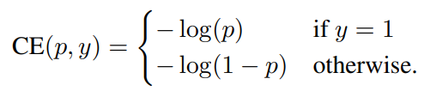
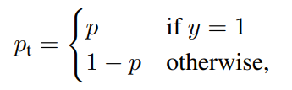


Experiments
Parameters of the deformable Transformer encoder are shared among different feature levels
Focal loss
Notes:
Focal loss is used to compensate the accuarcy difference between one stage object detector and two stage object detector. (1) training is inefficient as most locations are easy negatives that contribute no useful learning signal;
(2) en masse, the easy negatives can overwhelm training and lead to degenerate models. Weights for different samples are same. Weight 2 is also utilized here in our deformable detr.

Slide 33
Experiments
Parameters of the deformable Transformer encoder are shared among different feature levels
Focal loss
Adam optimizer

Slide 34
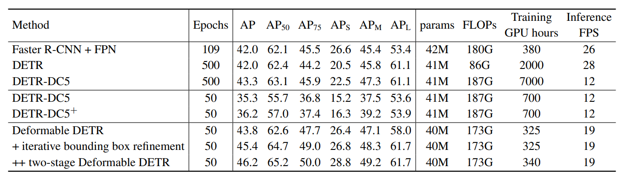
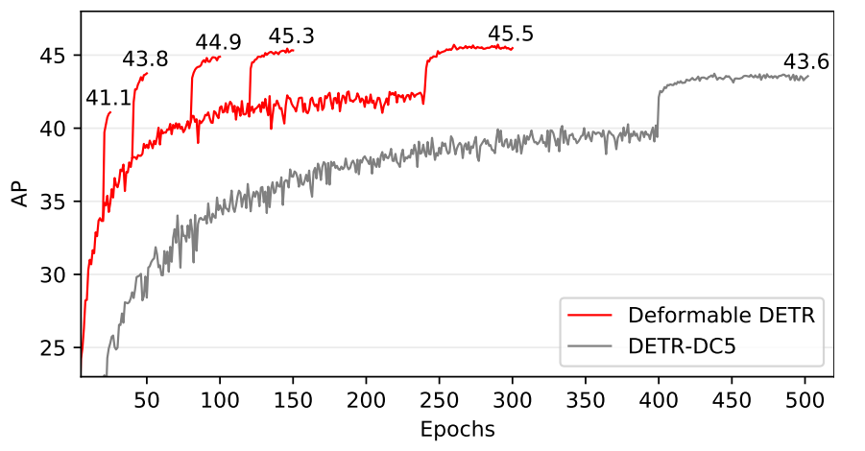
Results
Notes:
As shown in Table 1, compared with Faster R-CNN + FPN, DETR requires many more training epochs to converge, and delivers lower performance at detecting small objects. Compared with DETR, Deformable DETR achieves better performance (especially on small objects) with 10× less training epochs. Detailed convergence curves are shown in Fig. 3. With the aid of iterative bounding box refinement and two-stage paradigm, our method can further improve the detection accuracy.
Learning rate is reduced

Slide 35
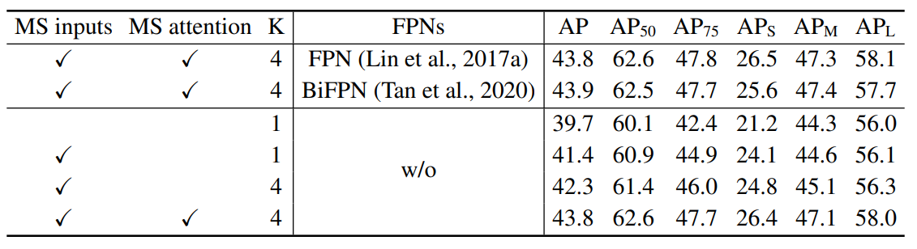
Results

Slide 36
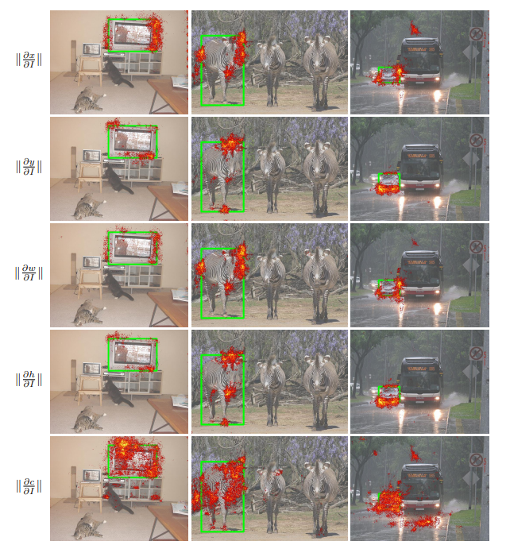
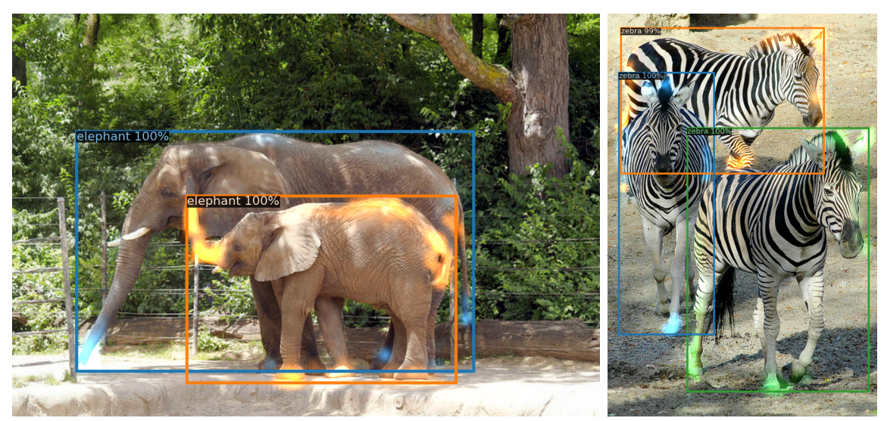
Results
Notes:
The visualization indicates that Deformable DETR looks at extreme points of the object to determine its bounding box, which is similar to the observation in DETR (Carion et al., 2020). More concretely, Deformable DETR attends to left/right boundary of the object for x coordinate and width, and top/bottom boundary for y coordinate and height. Meanwhile, different to DETR (Carion et al., 2020), our Deformable DETR also looks at pixels inside the object for predicting its category. we can guess the reason is that our Deformable DETR needs not only extreme points but also interior points to detemine object category

